Slide 1
IceCube Management and Operations
K. Hanson | 2019.09.20
International Oversight and Finance Group Meeting
Chiba, Japan

Slide 2
Technical Performance

Slide 3
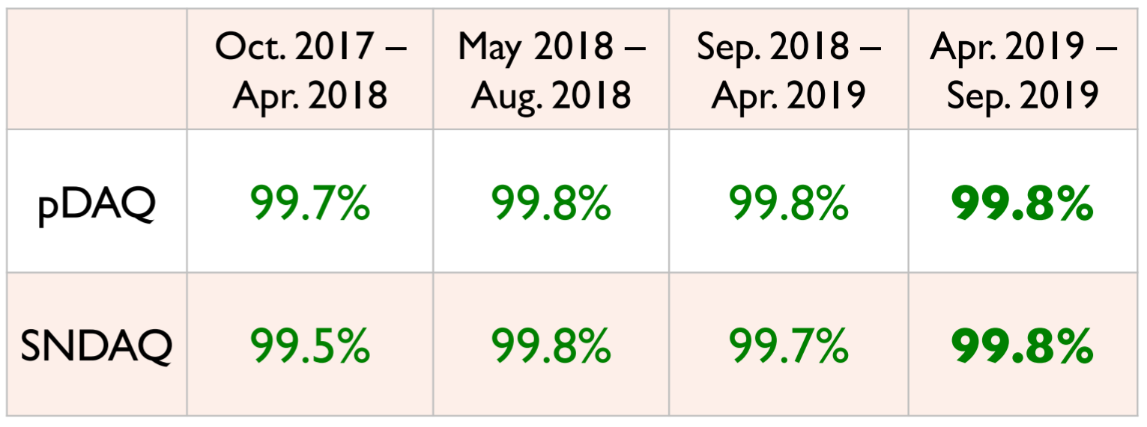
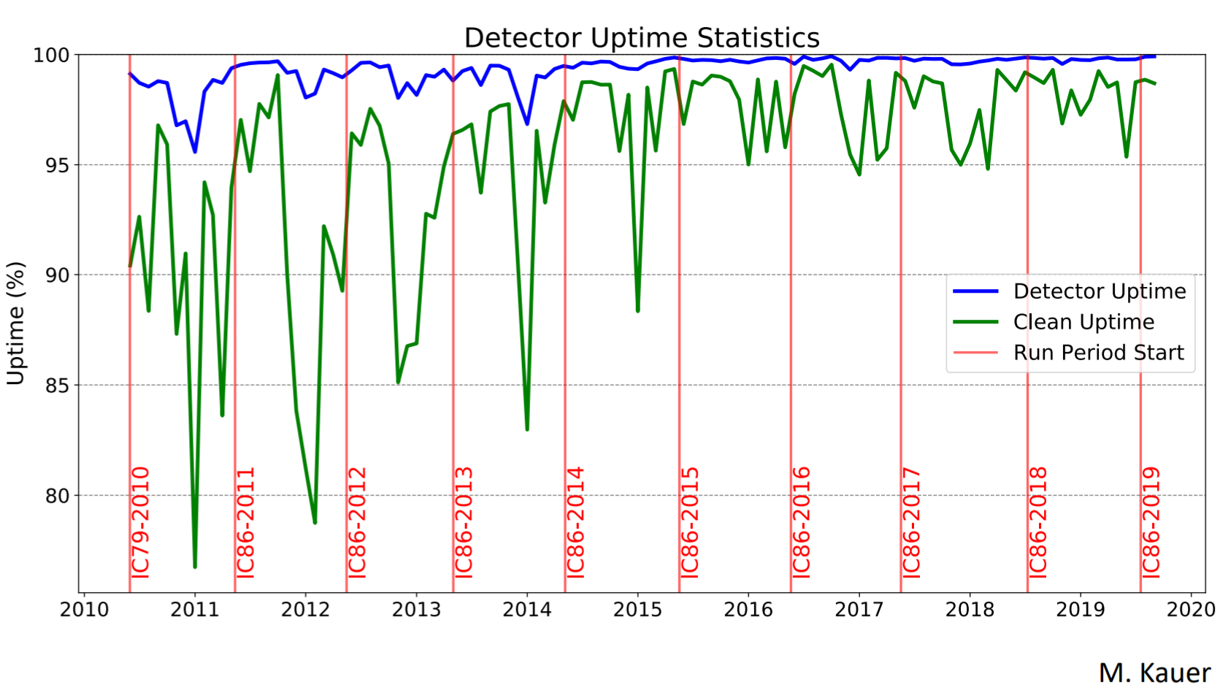
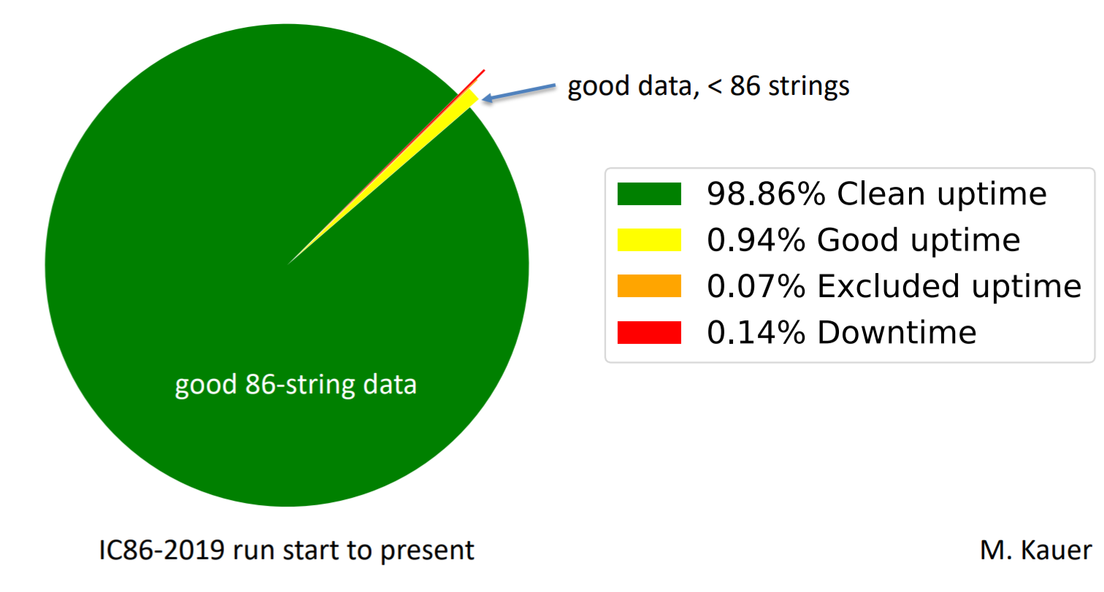
Detector Uptime

Slide 4
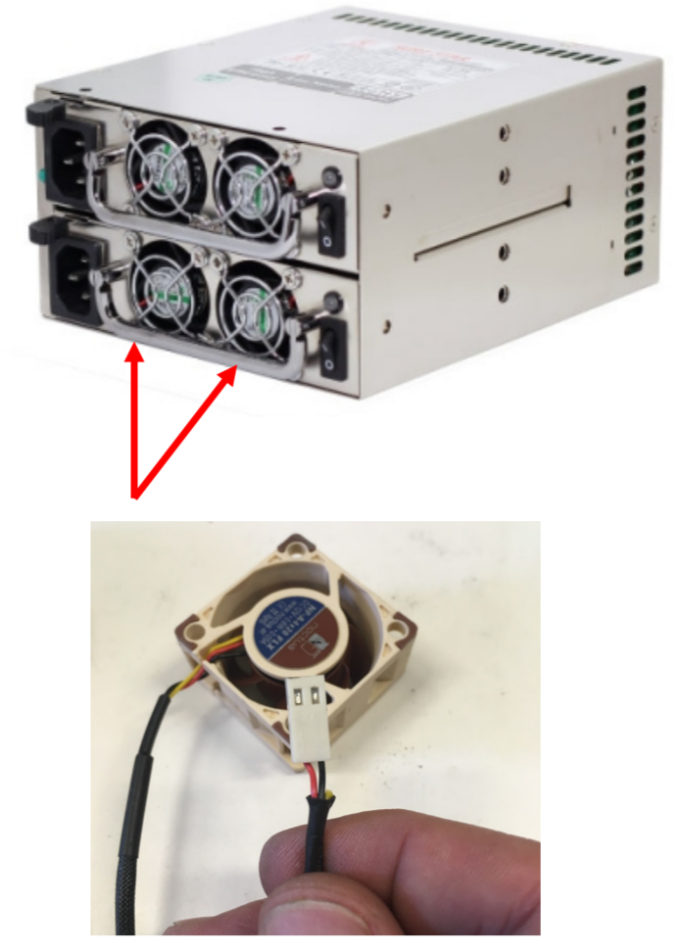
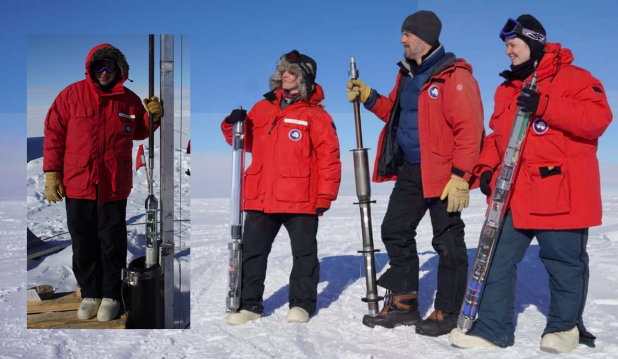
IceCube M&O Polar Season 2019-2020 (Note Upgrade is now Separate Event #)
South Pole System Server / DOMHub Maintenance
Server lifetime replacement: 50% last season – 50% this season. Will not impact detector uptime (can relocate critical online systems to avoid interruption of data taking).
DOMHubs require power supply and fan replacement.
SpiceCore
SpiceCore is a 14 cm borehole about 1 km off edge of IceCube kept open with Estisol-140 antifreeze. Opportunity to deploy calibration devices for IceCube:
(Imaging) camera
UV probe
Dust measurements
Luminescence measurements
Surface Detector Maintenance
Scintillator and prototype cosmic ray radio antenna detector refurbishment / DAQ upgrade.
IceACT telescope (air Cherenkov telescopes) maintenance.

Slide 5
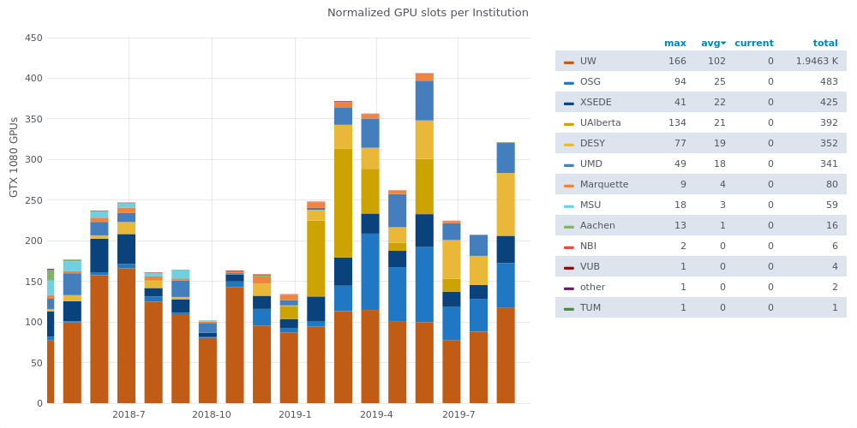
Computing Resources - GPU

Slide 6
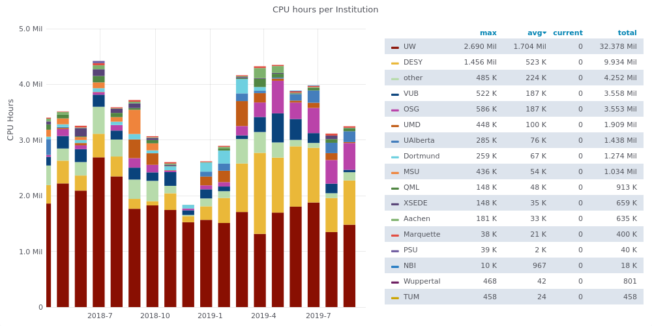
Computing Resources - CPU

Slide 7
Computing Pledges
Institution | CPU | GPU
Aachen | 10 | 0
Alberta | 1200 | 144
Brussels | 400 | 14
DESY | 1400 | 180
Dortmund | 400 | 48
LBNL | 114 | 0
Marquette | 96 | 16
MSU | 750 | 100
NBI | 0 | 10
Queen’s/King’s College | 0 | 55
UMD | 350 | 36
UW-Madison | 6000 | 400
Wuppertal | 500 | 64

Slide 8
Financial Performance

Slide 9
IceCube NSF M&O Award Budget, Actual Cost and Forecast
(a) | (b) | (c) | (d)= a - b - c | (e) | (f) = d – e
YEARS 1-4 Budget (Apr.’16-Mar.’20) | Actual Cost To Date through 08/31/19 | Open Commitments 08/31/19 | Current Balance 08/31/19 | YEAR4 Remaining Projected Expenses Sep'19-Mar‘20 | End of YEAR4 Forecast Balance 03/31/20
$28,360K | $23,719K | $1,213K | $3,428K | $3,503K | -$74K
This five-year NSF M&O renewal award started in April 2016.
NSF award of $7M per year: $35M total
NSF Supplemental funding of $292K to develop a multimessenger INCLUDES program and $68K for SDSM&T
Total actual cost as of August 31, 2019 is $23,719K and open commitments are $1,213K. The current balance as of August 31, 2019 is $3,428K. With a projection of $3,503K for the remaining expenses during the final seven months of PY04, the estimated overspent funds at the end of PY04 are -$74K (-0.3% of the total PY01-PY04 budget).
Negative projected balance was reduced with the start of the NSF IceCube Upgrade award.

Slide 10
IceCube M&O Computing Infrastructure Common Fund Expenditures
System Upgrade | Computing Infrastructure | Detector Infrastructure | Labor | Total
South Pole System | $311K | $81K | $574K | $966K
South Pole Test System | $256K | $12K |  | $268K
Data Warehouse | $662K |  |  | $662K
UW Data Center | $318K |  |  | $318K
TOTAL | $1,547K | $93K | $574K | $2,214K
This summary includes the major purchases for the 2018/2019 upgrades of the South Pole System (SPS), South Pole Test System (SPTS), UW Data Center, UW Data Warehouse and networking equipment that are funded by IceCube M&O Common Fund.
Detailed expenditures information by cost category, vendor, quantity and line item description can be found in the annual Common Fund Status reports on Docushare:
https://docushare.icecube.wisc.edu/dsweb/View/Collection-8986

Slide 11
The IceCube Coordination Committee

Slide 12
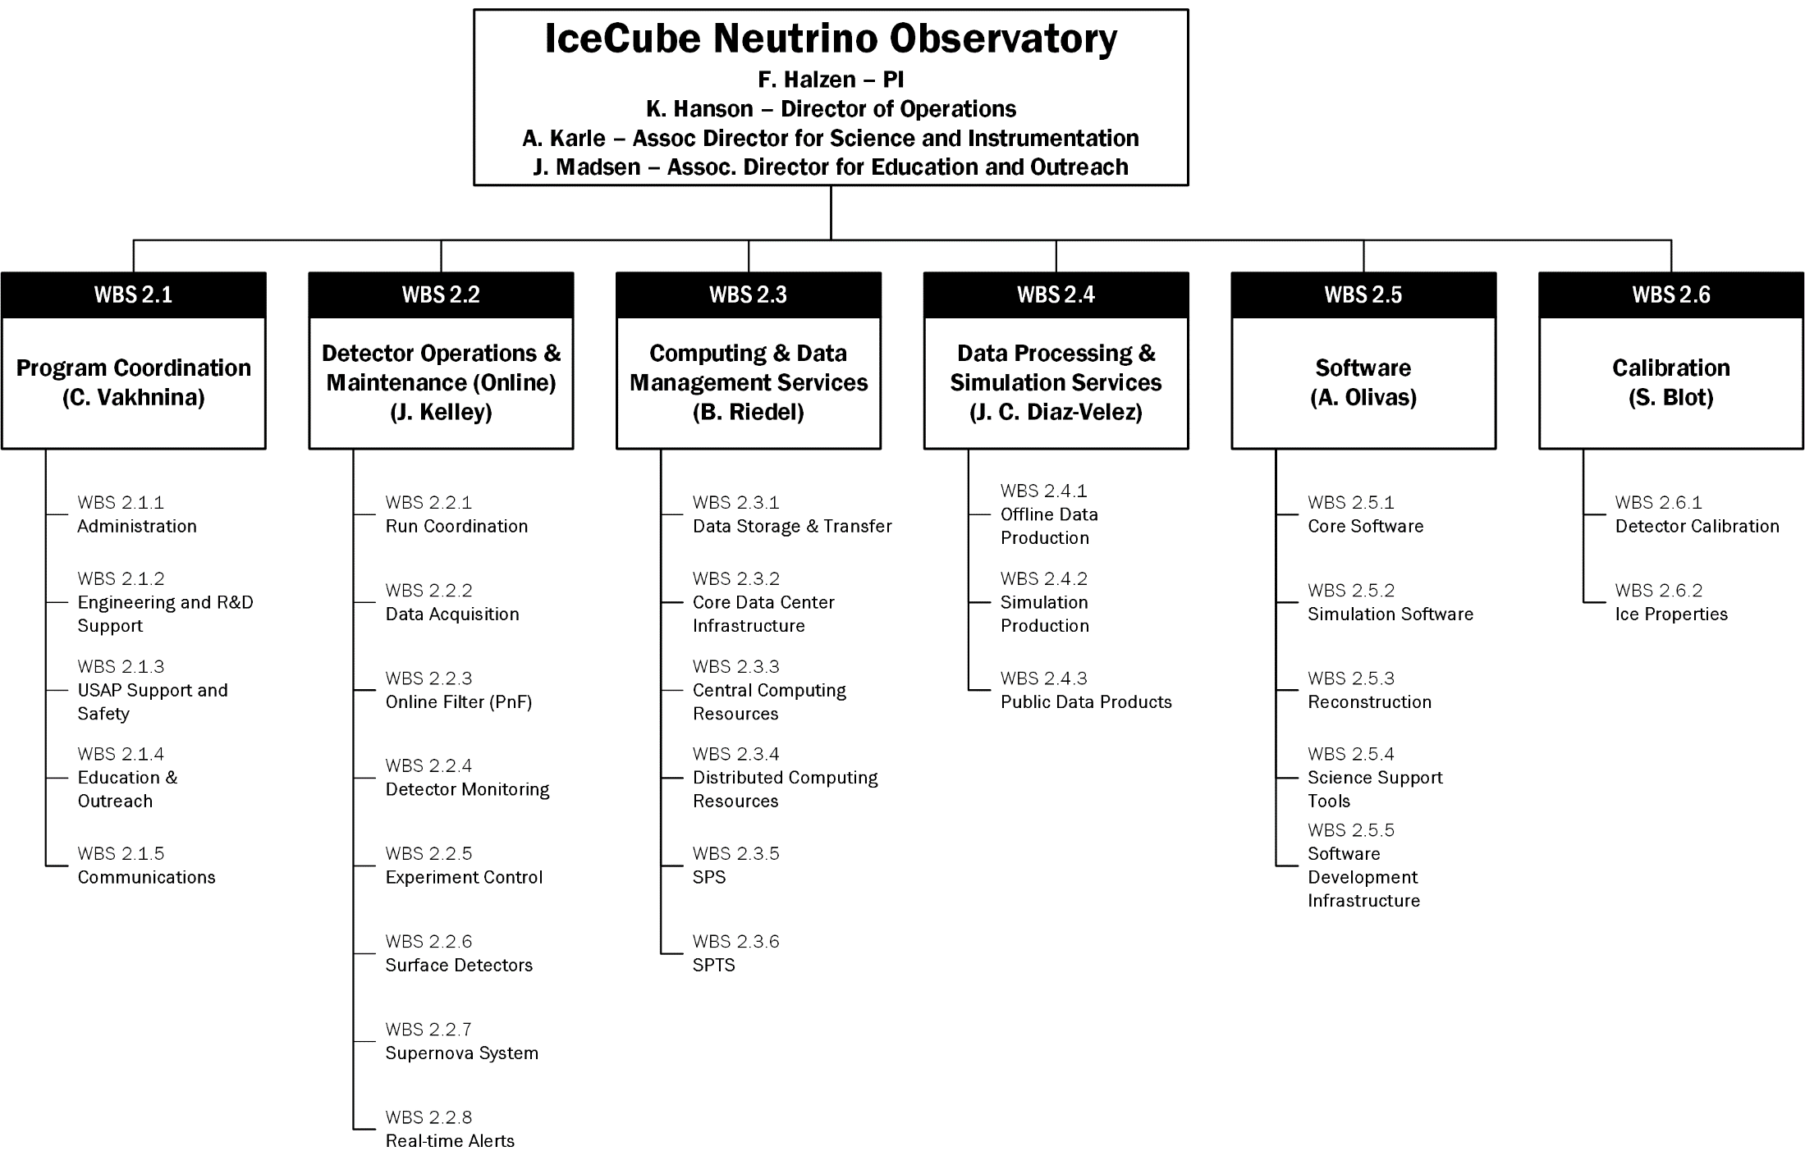
IceCube Coordinator Committee - Status
Purpose: resource coordination for IceCube M&O to help IceCube Collaboration achieve its scientific goals. This includes labor resources as well as computing pledges. Match resources with tasks or computing needs identified as having global interest.
More centralized
More distributed

Slide 13
Recent Activity in IceCube Coordination Committee
3 ICC and 6 Bi-Weekly teleconferences since Madison meeting.
Pass 3 – Updated Wavedeform
Weekly phone call 2019.05.21: “no compelling evidence yet that pass3 reprocessed data will deliver better science than pass2.”
Estimation of cost of computing to reprocess data $500k - $1M.
Decision to postpone Pass3 yet keep checking for possible artifacts of wavedeform in data at higher level.
Level 2 Cleanup
Motivated by pass3 preparations.
Remove old dross in L2 scripts, leaner, lower resource requirement.
Total Re-do on Semi-Annual Resource Pledges & Tracking
Previously, there was the Task Vacancy List. Unwieldy, moved around several times, not very visible throughout collaboration. This didn’t work.
Alex / Benedikt / Paolo recommended going to cloud-based project management system.
Smartsheets chosen after evaluation of several options – also used as PM tool for Upgrade.

Slide 14
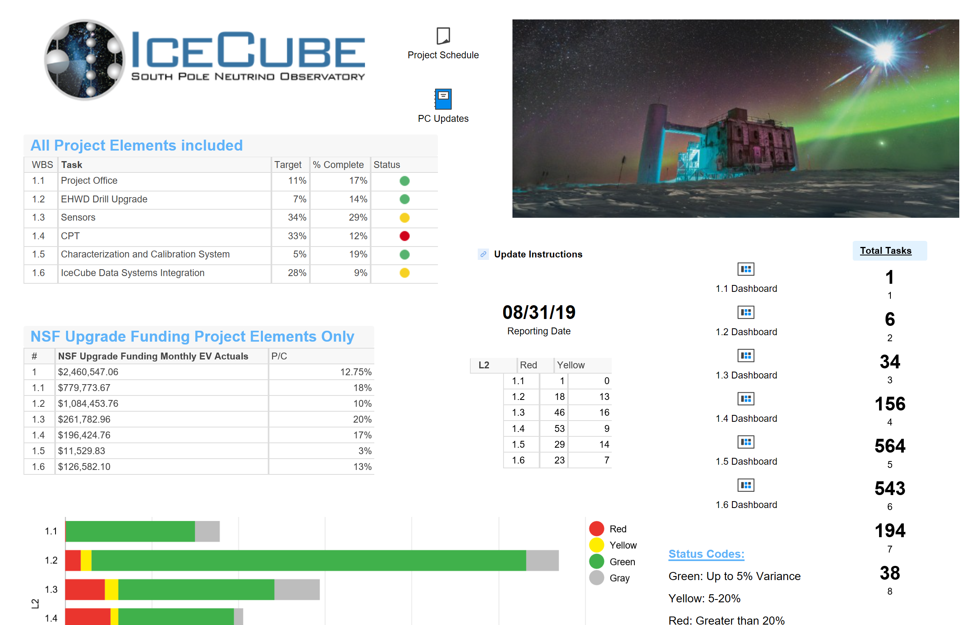
SmartSheet Based Solution
Excel on steroids
More than worksheets. Dashboards can be created that pull information from sheets.
Tasks will be entered into “database” – can be created either by ICC / Coordinators / WG Tech Leads and Institutional Leads.
Resources defined / maintained by ILs (existing resources from v27 of SoWs will be pulled over automatically).
Assignments of resources to tasks done by ILs through Smartsheet form.
Roll out plan:
Beta testing with O(3-4) institutions this Fall
v28 for Brussels will be done 100% through Smartsheets.
Upgrade in-kind resources and tasks will be tracked as well via this mechanism and will be counted as effort.
IceCube Upgrade Top-Level Dashboard

